Slide 1
Beers of the USA
Group 1

Slide 2

Beers of the USA
Group 1
Gabriel A.
Chad D.
Jeremy J.
Nick O.
Debra W.
“I DON’T ALWAYS DRINK BEER, BUT WHEN I DO, IT’S FROM THE USA”

Slide 3
Overview
Our dashboard focused on querying data from a brewery dataset (csv) so that users can query a name of beer using a drop down menu from beers/breweries within the US. Once the user has picked a beer, the dashboard visuals will change accordingly.

Slide 4
Group Members
Gabriel Alade, Chad Dubiel, Jeremy Jones, Nick Orewiler, and Debra Wu

Slide 5
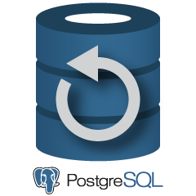






Workflow
SQL database in Postgres server.
Web visualization
- Flask
- Static html
Web application framework JSON API
Data manipulation, cleaning, and mining. Database connection.
Json API reader, Jquery, D3, Leaflet.
csv Files (4) located in data folder.

Slide 6
Data Set
The data for this project can be found at the link below.
The Beer | Kaggle
Git Hub link to Repository
j1-aggie/Project-2 (github.com)

Slide 7
Steps to recreate
Clone the project repository to your computer.
Open a session in Postgres SQL and create a database titled “beersDB”.
Run the notebook “analysis.ipynb”, this will load csv into the different tables in the “beersDB”.
Start up the Flask application app.py and run inside the project folder in the command prompt
Open the site on localhost:5000 and enjoy.
Use the drop down menu to pick different beers and watch the dashboard change.

Slide 8
Dashboard Presentation
Move to dashboard.

